Slide 1


A Data-Driven Look at What Resonates on Social Media

Slide 2


Today's agenda
Project recap
Problem
The Analytics team
Process
Insights
Summary

Slide 3

An analysis of Social Buzz’s content that highlights the top 5 categories with the largest aggregate popularity
Project Recap
Providing useful insights via visualization
Handle the Big Data

Slide 4


Problem
Due to Social Buzz’s rapid growth and digital nature of their core product, the amount of data that they create, collect and must analyze is huge.
They are still a small company and do not have the resources to manage the scale that they are currently at. They have asked us as a 3-rd party to highlight their weak and strength spots via their big data analysis.

Slide 5
Andrew Fleming (Chief Technical Architect)
The Analytics team
Marcus Rompton (Senior Principle)
Mohammadhossein Yousefi (Junior Data Analyst

Slide 6
Process
1
Identify the business problem and store data
2
Data cleaning process
3
Data Modeling and Analyzing
4
Data visualization
5
Uncover Insights

Slide 7

Insights

Slide 8
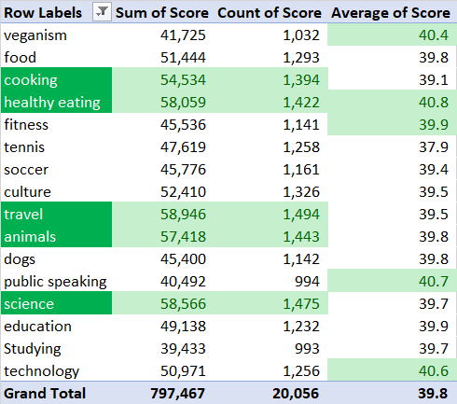
Top categories based on the sum of their scores, average of their scores, and the number of feedbacks

Slide 9
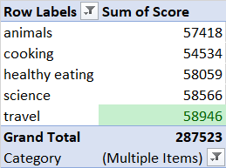
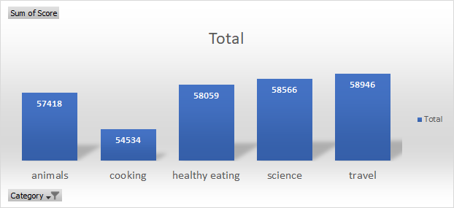
Comparison among the 5 five categories based on their total scores

Slide 10
Top months based on number of posts uploaded

Slide 11

The 5 most popular categories are as followed: Travel, Science, Healthy-eating, Cooking, and Animals
Travel category has had the most feedbacks
Healthy-eating has had also the best average score among other categories
Among past 12 months (current month not included) last August (2020), January (2021), and May (2021) has had the most Posts
Summary

Slide 12

Thank you!
ANY QUESTIONS?

